Slide 1

Conditional Statement (if)
unitPrice = 1.30;
if (quantity > 100) {
unitPrice = 1.20;
}
Symbol
Meaning
>
Greater than
<
Less than
>=
Greater than or equal to
Less than or equal to
==
Equal
!=
Not equal

Slide 2
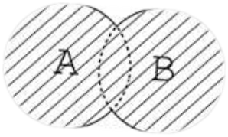
Conditional Statement (if) (2)
The condition may be of Boolean or integer type:
conditional-statements.html
var a = 0;
var b = true;
if (typeof(a)=="undefined" || typeof(b)=="undefined") {
document.write("Variable a or b is undefined.");
}
else if (!a && b) {
document.write("a==0; b==true;");
} else {
document.write("a==" + a + "; b==" + b + ";");
}

Slide 3
Switch Statement
The switch statement works like in C#:
switch-statements.html
switch (variable) {
case 1:
// do something
break;
case 'a':
// do something else
break;
case 3.14:
// another code
break;
default:
// something completely different
}

Slide 4


Loops
Like in C#
    for loop
    while loop
    do … while loop
var counter;
for (counter=0; counter<4; counter++) {
alert(counter);
}
while (counter < 5) {
alert(++counter);
}
loops.html

